Slide 1
DSA &C++
Sorting Algorithms
shorturl.at/ipGZ9

Slide 2
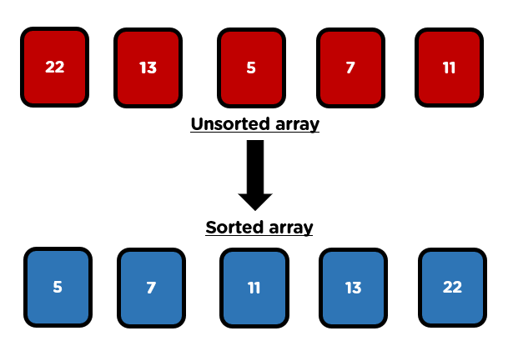

Slide 3
Introduction
Sorting refers to simply the process of arranging the data elements of an array in a specified order, that is, either in ascending or descending order.
For example, it will be practically impossible for us to find a name in the telephone directory if the names in it are not in alphabetical order. However, the same can be true for dictionaries, book indexes, bank accounts, and so on.
Hence, the convenience of having sorted data is unquestionable. Retrieval of information becomes much easier when the data is stored in some specified order. Therefore, sorting is a very important application in computer science. Arranging things in a sorted manner makes it easier to analyze and search for a particular element among the collection of elements.
A sorting algorithm can be defined as an algorithm that puts the data elements of an array/ list in a certain order, that is, either numerical order or any predefined order. There are many sorting algorithms that are available and are widely used according to the different environments required by the different sorting methods.

Slide 4
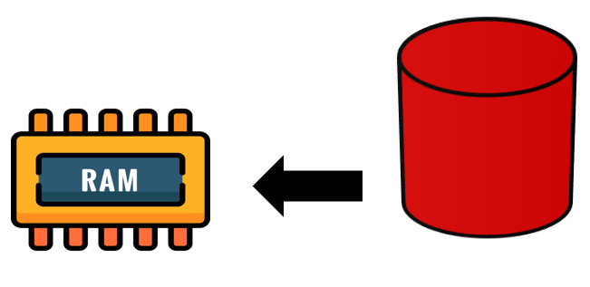
Categories of Sorting
The two basic categories of sorting methods are:
Internal Sorting – It refers to the sorting of the data elements stored in the computer’s main memory.
Example: Buble, selection and insertion sort
External Sorting – It refers to the sorting of the data elements stored in the files. It is applied when the amount of data is large and cannot be stored in the main memory.
Example: Merge Sort

Slide 5
Types of Sorting
There are various types of sorting techniques in C++. We will be learning the most popular ones in this article.
Bubble sort
Insertion sort
Selection sort
Quick sort
Merge Sort
See also more sorting algorithms
Counting
Bucket
Radix
heap

Slide 6
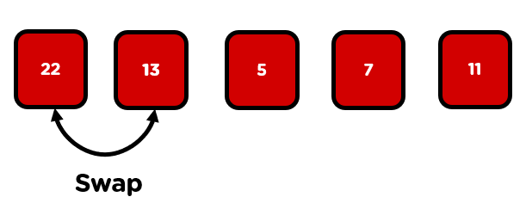
Buble Sort
Bubble Sort is the very simplest sorting algorithm that works by repeatedly swapping the adjacent elements if they are in the wrong order. In this sorting technique, we begin by comparing the first two elements of the array and checking if the first element is greater than the second element; if it is, we will swap those elements and move forward to the next element
If the first element is not greater than the second, then we don’t need to swap it. And this process will keep on repeating till the end of the array.

Slide 7
Buble sort(next…)
With Bubble Sort , two successive elements are compared with each other, and – if the left element is larger than the right one – they are swapped.
These comparison and swap operations are performed from left to right across all elements. Therefore, after the first pass, the largest element is positioned on the far right. Or better: at the latest after the first pass – it may have arrived there before.
You repeat this process until the array is sorted.
Let’s use an example for the better understanding, In the following visualizations, I show how to sort the array [22,13,5,7,11] with Bubble Sort:

Slide 8
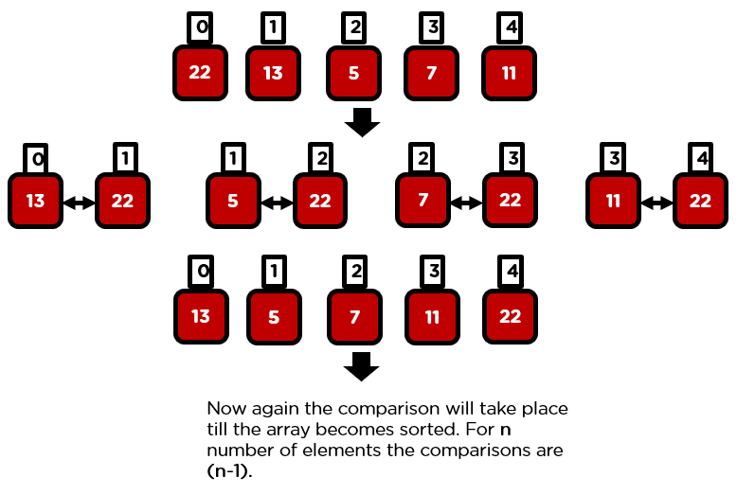
Buble sort(next..)
We divide the array into a left, unsorted – and a right sorted part. The right part is empty at the beginning:
Iteration 1:
We compare the first two elements, the 22 and the 13, and since 13 is smaller, we swap the elements:
Now we compare the second with the third element, i.e., the 22 with the 5. These are also in the wrong order and are, therefore, swapped.
We compare the third with the fourth element, i.e., the 22 with the 7, they are also swapped.

Slide 9
Example1: Visual Interpretation
Input: arr[] = {22,13,5,7,11}
Comparison 1:
Bubble sort starts with very first two elements, comparing them to check which one is greater.
{22,13,5,7,11}–> {13,22,5,7,11} Here, algorithm compares the first two elements, and swaps since 22 > 13.
{13,22,5,7,11} –> {13,5,22,7,11} , Swap since 22 > 5
{13,5,22,7,11} –> {13,5,7,22,11}, Swap since 22 > 7
{13,5,7,22,11} -> {13,5,7,11, 22}, Swap since 22>11.
Comparison 2:
Bubble sort in the second iteration will look like this:
{13,5,7,11, 22}–> {5,13, 7,11, 22} Here, algorithm compares the first two elements, and swaps since 13 > 5.
{5,13, 7,11, 22} –> {5,7,13,11, 22} , Swap since 13 > 7
{5,7,13,11, 22} –> {5,7,11,13, 22} Swap since 13 > 11
{5,7,11,13, 22} -> {5,7,11,13, 22} , No Swap since 13<22.
Comparison 3:
Currently, the array is sorted, but our algorithm does not know if it is completed.
The algorithm needs one whole pass without any swap to know it is sorted.
{5,7,11,13, 22} –> {5,7,11,13, 22}
{5,7,11,13, 22} –> {5,7,11,13, 22}
{5,7,11,13, 22} –>{5,7,11,13, 22}
{5,7,11,13, 22} –>{5,7,11,13, 22}

Slide 10
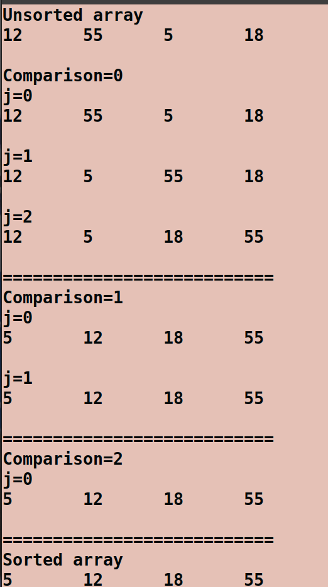
Example 2: Steps and Number of Comparison
// n=4, comparison=n-1
int arr[4]={12,55,5,18};
The number of comparison is always n-1
If arr[j] is greater than arr[j+1] then swap these adjacent elements, else move on

Slide 11
Example 2: Steps and Number of Comparison
#include<iostream>
using namespace std;
int main(){
int iteration,j,temp,n=9;
int num[n]={1,2,3,4,5,6,7,8,9};
cout<<" The unsorted array"<<endl;
for(int i=0;i<n;i++){
cout<<num[i]<<"\t";
}
cout<<endl;
for(iteration=1;iteration<n;iteration++){
cout<<"Iteration="<<iteration<<endl;
int check=0;
for (j=0;j<n-1;j++){
if(num[j+1]<num[j]){
temp=num[j];
num[j]=num[j+1];
num[j+1]=temp;
check=1;
}
cout<<endl;
cout<<"J="<<j<<endl;
for(int k=0;k<n;k++){
cout<<num[k]<<"\t";
}
cout<<endl;
}
if(check==0){
break;
}
}
cout<<"The sorted array is "<<endl;
for(int i=0;i<n;i++){
cout<<num[i]<<"\t";
}
cout<<endl;
return 0;
}

Slide 12
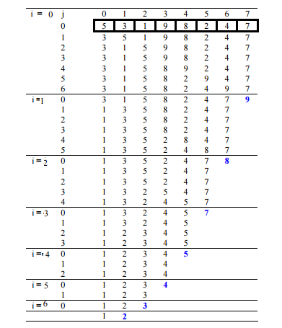
Example 3:Visual illustration
int numbers[7]={5,3,1,9,8,2,4,7};
The number of comparison is always n-1
If arr[j] is greater than arr[j+1] then swap these adjacent elements, else move on

Slide 13
C++ Program
for(count=1;count<=n-1;count++){
for(j=0;j<=n-2;j++)
{
if(arr[j+1]<arr[j]){
temp=arr[j];
arr[j]=arr[j+1];
arr[j+1]=temp;
}
}
}
cout<<"Sorted array"<<endl;
for(i=0;i<n;i++){
cout<< arr[i]<<"\t";
}
cout<<endl;
return 0;
}
#include<iostream>
using namespace std;
int main(){
int i,count,j,temp,n=8;
int arr[8]={12,3,1,5,18,10,7,35};
cout<<"Unsorted array"<<endl;
for(i=0;i<n;i++){
cout<< arr[i]<<"\t";
}
cout<<endl;
cout<<endl;

Slide 14
C++ Program with Swap function
#include<iostream>
using namespace std;
int main(){
int i,count,j,temp,n=8;
int arr[8]={12,3,1,5,18,10,7,35};
cout<<"Unsorted array"<<endl;
for(i=0;i<n;i++){
cout<< arr[i]<<"\t";
}
cout<<endl;
cout<<endl;
for(count=1;count<=n-1;count++){
for(j=0;j<=n-2;j++)
{
if(arr[j+1]<arr[j]){
swap(arr[j],arr[j+1]);
}
}
}
cout<<"Sorted array"<<endl;
for(i=0;i<n;i++){
cout<< arr[i]<<"\t";
}
cout<<endl;
return 0;
}

Slide 15
Introduction to Time Complexity
In the Bubble sort:
The inner loop will executes n-1 times
The outer loop will execute n-1 times
The number of steps=(n-1)*(n-1);
=n²+n+c
⋍n²
The number of steps is called the Time complexity(How many steps the program took to execute?)
The time complexity is written with notation O
The time complexity of Bubble sort is O(n²)
Note: The time complexity assists to make a choice of the best algorithm with a least amount of time

Slide 16

As we can see in the above example, we have an unsorted array containing elements
12, 3, 1, 5, 18, 10, 7 and 35.
Run a nested for loop to traverse the input array using two variables i and j, such that 0 ≤ i < n-1 and 0 ≤ j < n-i-1
If arr[j] is greater than arr[j+1] then swap these adjacent elements, else move on
j must be not greater than n-2 to avoid segmentation fault
To sort n numbers, perform a sorting of n-1 numbers.
In the first iteration, the first largest number reaches its final position, in the second iteration the second largest reaches its final position, and the process continue.
Print the sorted array
The output will look like this:

Slide 17
Exercise: Indicate the steps and comparison of the bubble sort of the following array sorted in reverse order
int arr[4]={55,18,12,5};

Slide 18
Optimisation of Bubble sort
Consider the following arrays A and B:
The time complexity of A is O(n²) and the time complexity of B is O(n²)
If the array is in the correct order, the same time complexity will be used. It can be optimized by stopping the algorithm if the inner loop didn’t cause any swap. This means the Sorted array will take n steps in the bubble sort.
8 | 9 | 12 | 5 | 20
5 | 8 | 9 | 12 | 20

Slide 19
Example: Bubble sort optimised
#include<iostream>
using namespace std;
int main(){
int i,count,j,temp,n=8;
int arr[8]={12,3,1,5,18,10,7,35};
cout<<"Unsorted array"<<endl;
for(i=0;i<n;i++){
cout<< arr[i]<<"\t";
}
cout<<endl;
cout<<endl;
for(count=1;count<=n-1;count++){
int check=0;
for(j=0;j<=n-2;j++)
{
if(arr[j+1]<arr[j]){
swap(arr[j],arr[j+1];
check=1;
}
}
if(check==0){
break;//The array is sorted
}
}
cout<<"Sorted array"<<endl;
for(i=0;i<n;i++){
cout<< arr[i]<<"\t";
}
cout<<endl;
return 0;
}

Slide 20
2. Insertion Sort
Insertion sort is a simple sorting algorithm that works similar to the way you sort playing cards in your hands. The array is virtually split into a sorted and an unsorted part. Values from the unsorted part are picked and placed at the correct position in the sorted part.
Algorithm
To sort an array of size n in ascending order:
Iterate from arr[1] to arr[n] over the array.
Compare the current element (key) to its predecessor. It starts by comparing the second element with the first element. If the second element is smaller than the first, then we will swap it.
If the key element is smaller than its predecessor, compare it to the elements before. Move the greater elements one position up to make space for the swapped element.

Slide 21
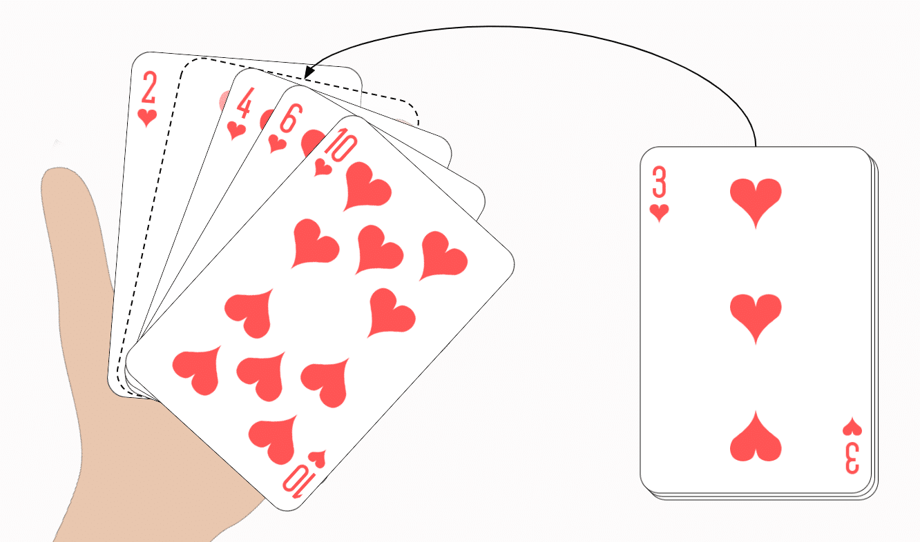
Let us go ahead with a playing card example.
Imagine being handed one card at a time. You take the first card in your hand. Then you sort the second card to the left or right of it. The third card is placed to the left, in between or to the right, depending on its size. And also, all the following cards are placed in the right position.
Have you ever sorted cards this way before?
If so, then you have intuitively used "Insertion Sort".
Let's move from the card example to the computer algorithm. Let us assume we have an array with the elements [6, 2, 4, 9, 3, 7]. This array should be sorted with Insertion Sort in ascending order.

Slide 22
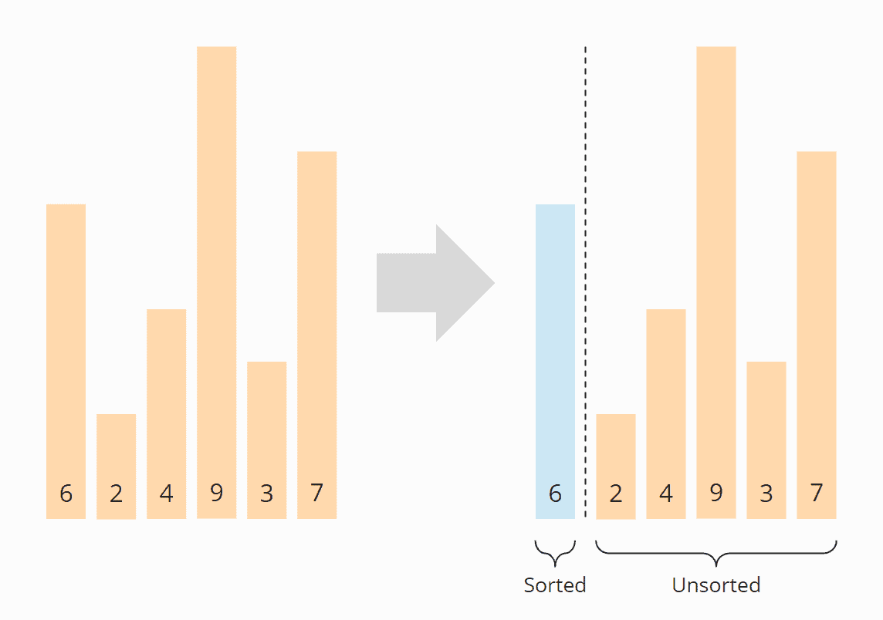
Step 1
First, we divide the array into a left, sorted part, and a right, unsorted part.
The sorted part already contains the first element at the beginning, because an array with a single element can always be considered sorted.

Slide 23
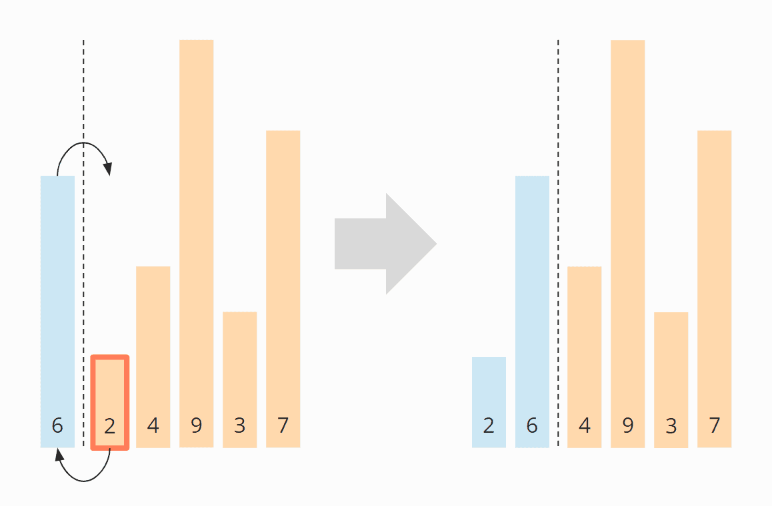
Step 2
Then we look at the first element of the unsorted area and check where, in the sorted area, it needs to be inserted by comparing it with its left neighbor.
In the example, the 2 is smaller than the 6, so it belongs to its left. In order to make room, we move the 6 one position to the right and then place the 2 on the empty field. Then we move the border between the sorted and unsorted area one step to the right:

Slide 24
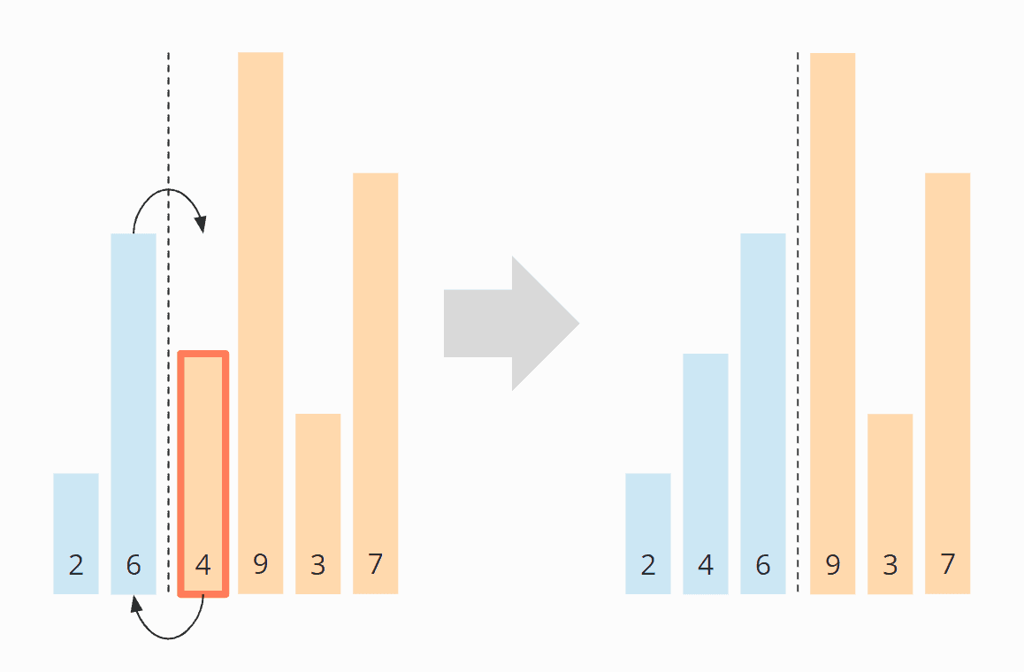
Step 3
We look again at the first element of the unsorted area, 4. It is smaller than 6, but not smaller than the 2 and, therefore, belongs between 2 and 6. So we move the 6 again one position to the right and place the 4 on the vacant field:

Slide 25
Step 4
The next element to be sorted is the 9, which is larger than its left neighbor 6, and thus larger than all elements in the sorted area. Therefore, it is already in the correct position, so we do not need to shift any element in this step.
Step 5
The next element is the 3, which is smaller than 9, 6, and 4, but greater than the 2. So we move the 9, 6, and 4 one position to the right and then put 3 where the 4 was before.

Slide 26
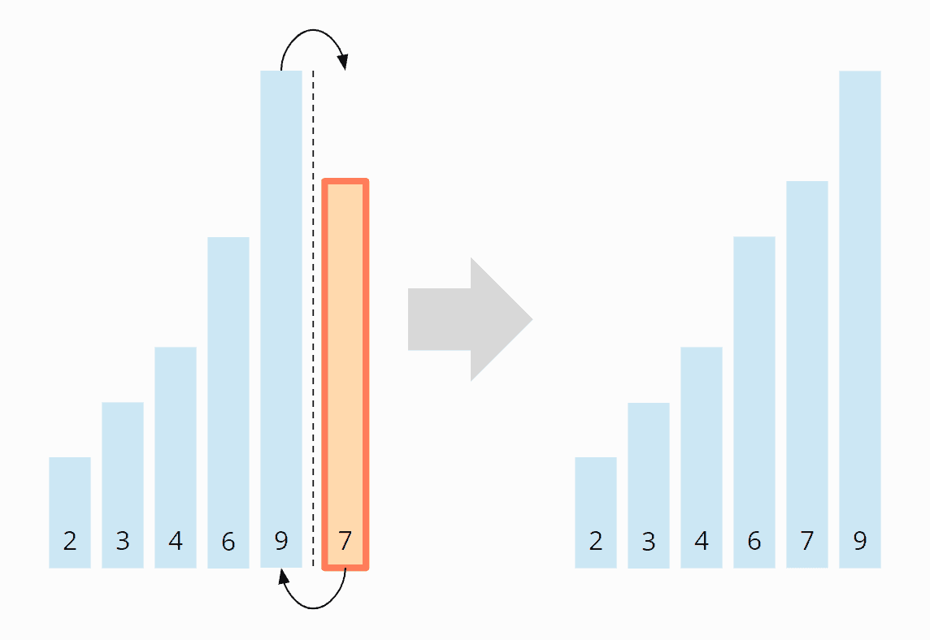
Step 6
That leaves the 7 – it is smaller than the 9, but larger than the 6, so we move the 9 one field to the right and place the 7 on the vacant position:

Slide 27
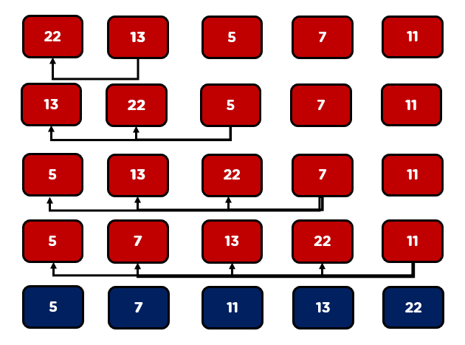

Slide 28
It starts by comparing the second element with the first element. If the second element is smaller than the first, then we will swap it.
After that, we will compare the third element with all the elements that are before it. Similarly, it goes for the fourth element and so on. Once all the comparisons are made, the elements become sorted.

Slide 29
C++ program
// C++ program for insertion sort #include <bits/stdc++.h> using namespace std; /* Function to sort an array using insertion sort*/ void insertionSort(int arr[], int n) { int i, key, j; for (i = 1; i < n; i++) { key = arr[i]; j = i - 1; /* Move elements of arr[0..i-1], that are greater than temp, to one position ahead of their current position */ while (j >= 0 && arr[j] > key) { arr[j + 1] = arr[j]; j = j - 1; } arr[j + 1] = key; } } }
// A function to print an array of size n void printArray(int arr[], int n) { int i; for (i = 0; i < n; i++) cout << arr[i] << " "; cout << endl; } /* Driver code */ int main() { int arr[] = { 12, 11, 13, 5, 6 }; int n = sizeof(arr) / sizeof(arr[0]); insertionSort(arr, n); printArray(arr, n); return 0;

Slide 30
A for loop is used, which is iterating from 1 to num-1; the loop starts from 1 because the comparison will start from index 1.
Inside the for loop, the array element is copied to the key variable, and j is set i-1 because we have to compare the element with its previous element.
Inside the while loop, there's a condition if the key is less than arr[j], that means if key which is storing the index 1 element is less than arr[j], which is index 0 element, then we will put arr[j] into its correct position, i.e., arr[j+1].
j=j-1 is used for decrementing the loop, as per the condition j must be greater than 0.

Slide 31
Exercise
1. Given the following array of 5 elements
int arr[] = { 12, 11, 13, 5, 6 };
Write a program to return the minimum and maximum number in the array

Slide 32
Selection Sort
Selection sort is a sorting technique that works by finding the smallest value in the array and placing it in the first position.
After that, it was then .
Thus, the selection sort works by finding the smallest unsorted element remaining in the entire array and then swapping it with the element in the next position to be filled.
It is a very simple technique, and it is also easier to implement than other sorting techniques. Selection sort is used for sorting files with large records.
Let’s take the same example as in the selection sort of playing cards.
The algorithm maintains two subarrays in a given array.
The subarray is already sorted.
The remaining subarray is unsorted.
In every iteration of selection sort, the minimum element (considering ascending order) from the unsorted subarray is picked and moved to the sorted subarray.

Slide 33
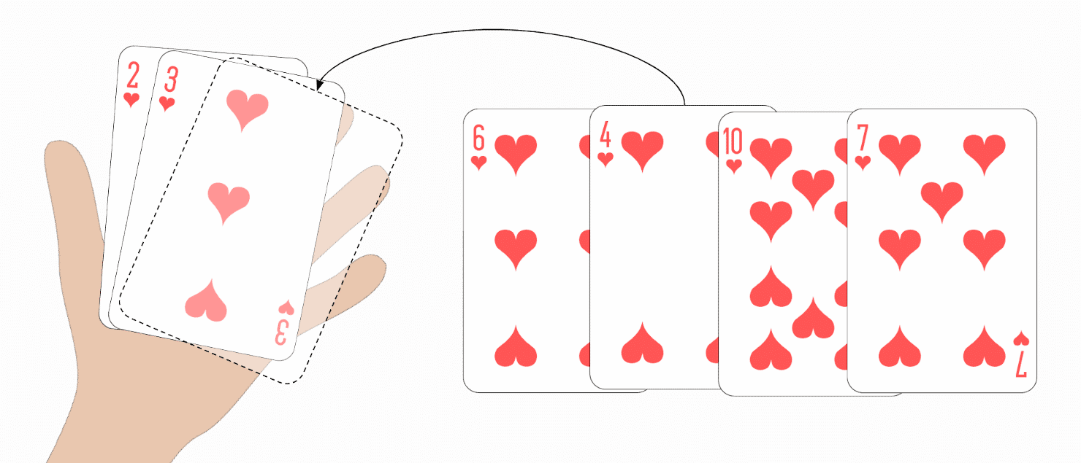
selection sort algorithm(next)
First, you lay all your cards face-up on the table in front of you. You look for the smallest card and take it to the left of your hand. Then you look for the next smaller card and place it to the right of the smallest card, and so on until you finally pick up the largest card to the far right.
Selection Sort Algorithm
The algorithm can be explained most simply by an example. In the following steps, I show how to sort the array [6, 2, 4, 9, 3, 7] with Selection Sort:

Slide 34
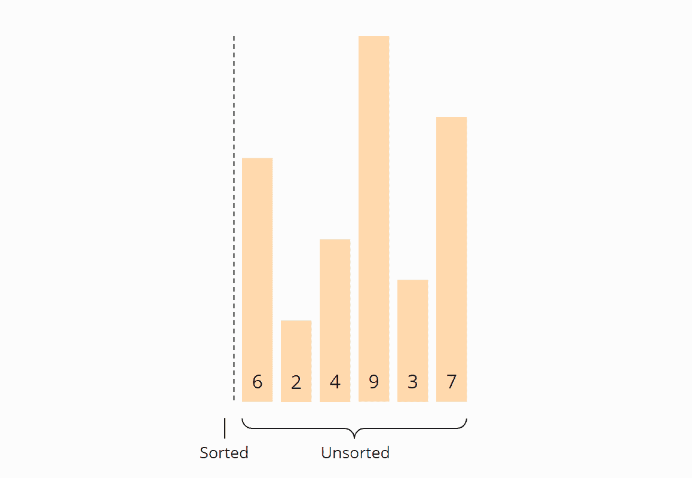
Step1
We divide the array into a left, sorted part and a right, unsorted part. The sorted part is empty at the beginning:
Notes:
https://afteracademy.com/blog/introduction-to-sorting-algorithms-selection-and-insertion-sort

Slide 35
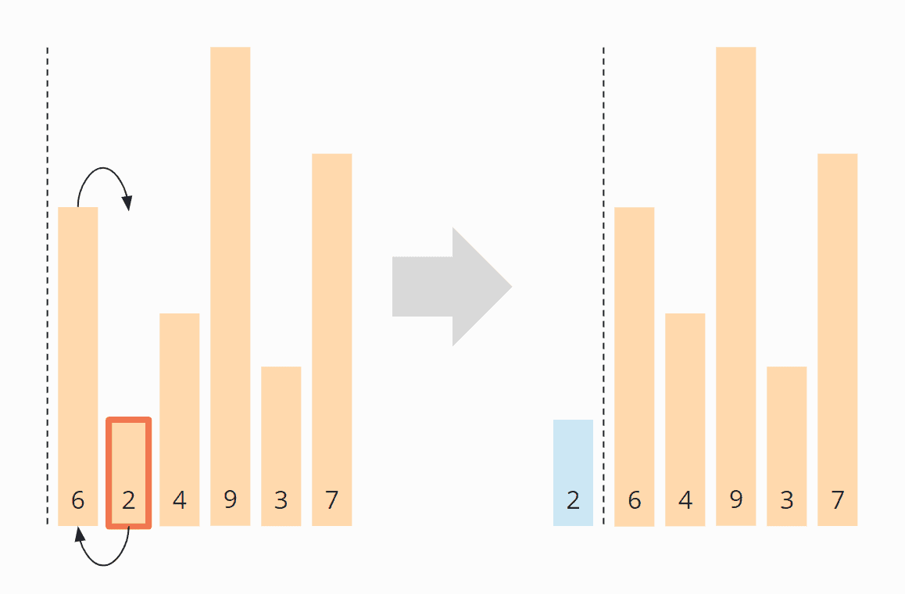
Step2
We search for the smallest element in the right, unsorted part. To do this, we first remember the first element, which is 6. We go to the next field, where we find an even smaller element is 2. We walk over the rest of the array, looking for a smaller element. Since we can't find one, we stick with 2. We put it in the correct position by swapping it with the element in the first place. Then we move the border between the array sections one field to the right:
We search again in the right, unsorted part for the smallest element. This time it is 3; we swap it with the element in the second position:
Animation” https://afteracademy.com/blog/introduction-to-sorting-algorithms-selection-and-insertion-sort

Slide 36
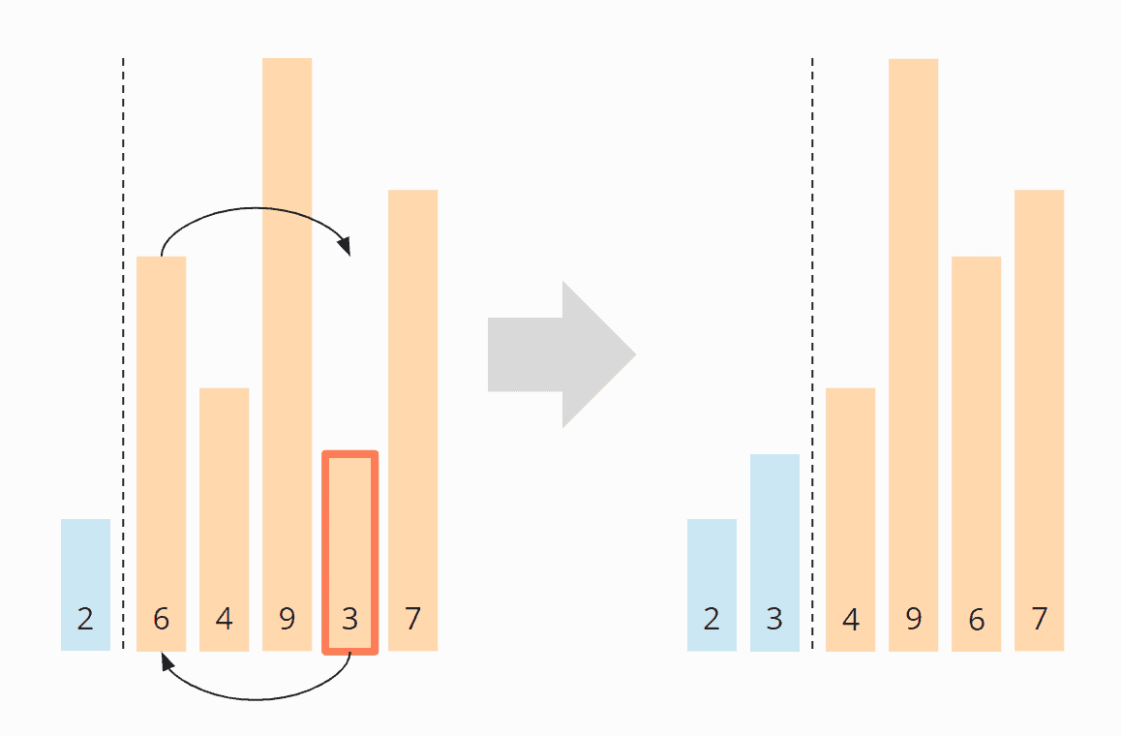
Step3
We search again in the right, unsorted part for the smallest element. This time it is the 3; we swap it with the element in the second position:
Notes:
https://afteracademy.com/blog/introduction-to-sorting-algorithms-selection-and-insertion-sort

Slide 37
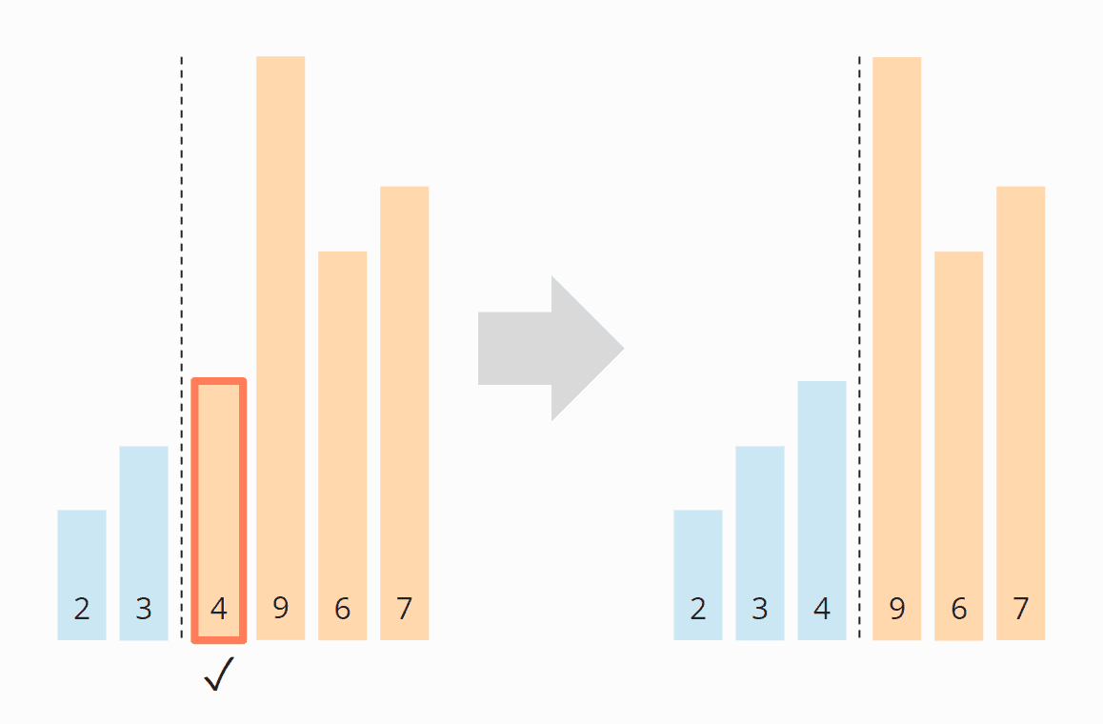
Step4
Again we search for the smallest element in the right section.
It is the 4, which is already in the correct position. So there is no need for swapping operation in this step, and we just -move the section border:
Notes:
https://afteracademy.com/blog/introduction-to-sorting-algorithms-selection-and-insertion-sort

Slide 38
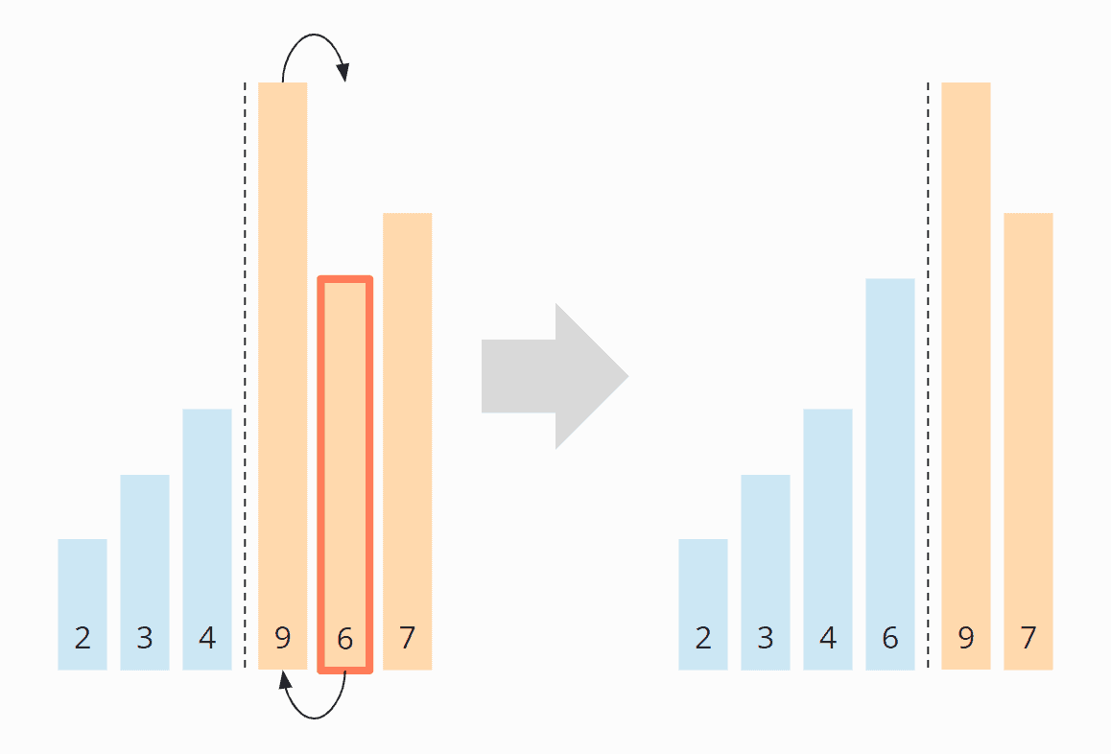
Step5
As the smallest element, we find the 6. We swap it with the element at the beginning of the right part, the 9:
Notes:
https://afteracademy.com/blog/introduction-to-sorting-algorithms-selection-and-insertion-sort

Slide 39
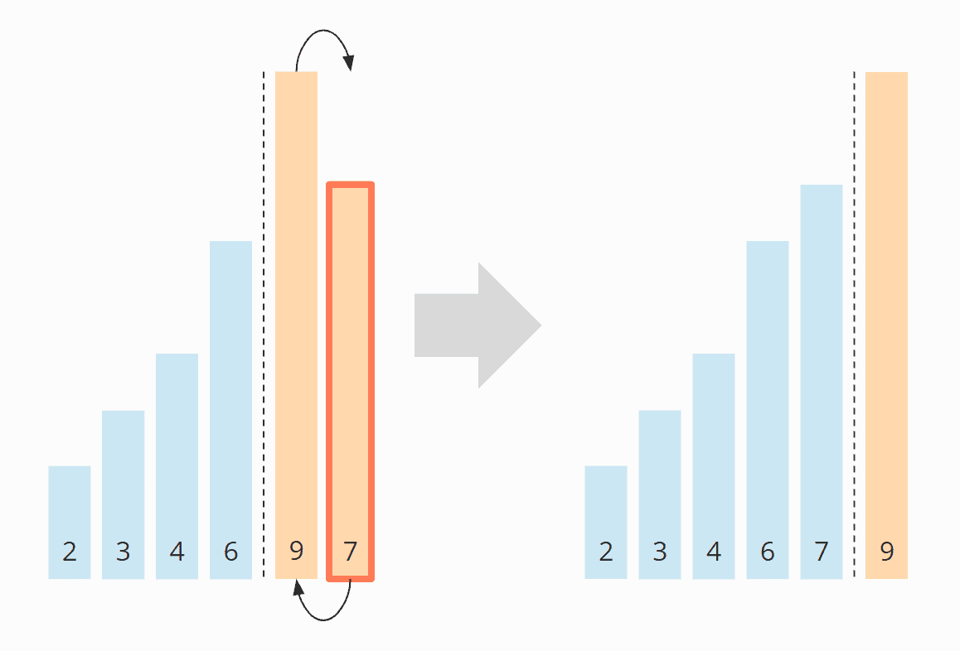
Step6
Of the remaining two elements, the 7 is the smallest. We swap it with the 9:
Notes:
https://afteracademy.com/blog/introduction-to-sorting-algorithms-selection-and-insertion-sort

Slide 40
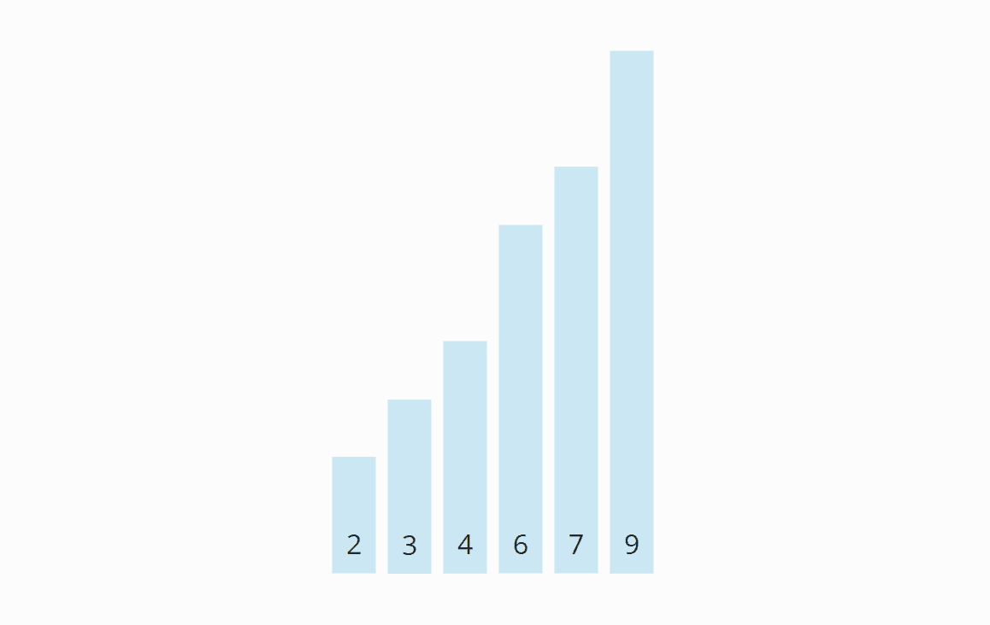
Algorithm finished
The last element is automatically the largest and, therefore, in the correct position. The algorithm is finished, and the elements are sorted:
Notes:
https://afteracademy.com/blog/introduction-to-sorting-algorithms-selection-and-insertion-sort

Slide 41
C++ example
int main(){
int n;
cout<<"Enter the number of elements"<<endl;
cin>>n;
int a[n];
cout<<"Enter "<<n<<" elements"<<endl;
for(int i=0;i<n;i++){
cin>>a[i];
}
selectionSort(a,n);
for(int i=0;i<n;i++){
cout<<a[i]<<" ";
}
return 0;
}
#include<iostream>
using namespace std;
void selectionSort(int a[],int n){
for(int i=0;i<n-1;i++){
int tergetIndex= i;
for(int j = i+1;j<n;j++){
if(a[j]<a[targetIndex]){
targetIndex = j;
}
}
swap(a[i],a[targetIndex]);
}
}

Slide 42
Merge Sort
Recursive Algorithm

Slide 43
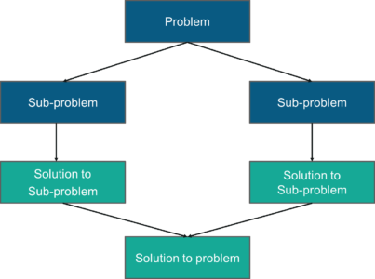
Merge Sort
Merge sort is one of the best examples of Divide & Conquer algorithm. Before we discuss alot about Merge sort algorithm, let us understand Divide & Conquer technique.
In Divide & Conquer algorithm design paradigm, we divide the problems in sub-problems recursively then solve the sub-problems, & at last combine the solutions to find the final result.
One thing to keep in mind while dividing the problems into sub-problems is that, the structure of sub-problems should not change as of the original problem.
Divide & Conquer algorithm has 3 steps:
1. Divide: Breaking the problem into subproblems
Compute Midpoint/mid index (m) = (left + right)/ 2
Here left is the starting(low) index & right is the last(high) index of the array(list)
2. Conquer: Recursively solving the subproblems
Call Merge Sort on the left sub-array (sub-list) starting from left to midpoint
Call Merge Sort on the right sub-array (sub-list) starting from midpoint+1 to high index
3. Combine: Combining the solutions to get the final result.
Call merge function to merge the divided sub-arrays back to the original array.
Perform sorting of these smaller sub arrays before merging them back.

Slide 44
Merge Sort (next…)
In Merge sort, we divide the array recursively in two halves, until each sub-array contains a single element, and then we merge the sub-array in a way that it results into a sorted array.
merge arrays function merges two sorted sub-arrays into one, wherein it assumes that array[l .. n] and arr[n+1 .. r] are sorted.

Slide 45
Merge sort(next…)
Merge sort is a very fast recursive sorting algorithm. If we ant to sort an empty array or with one element, the array is sorted. Then what about the recursive case. We must divide the array in two parts:
Then call the merge sort on small arrays.
After recursive merge sort, the two arrays are sorted
Then merge the two sorted arrays
arr
5 | 4 | 2 | 3 | 7 | 1
start(s)
mid(m)
end(s)
5 | 4 | 2
3 | 7 | 1
2 | 4 | 5
1 | 3 | 7
1 | 2 | 3 | 4 | 5 | 7

Slide 46
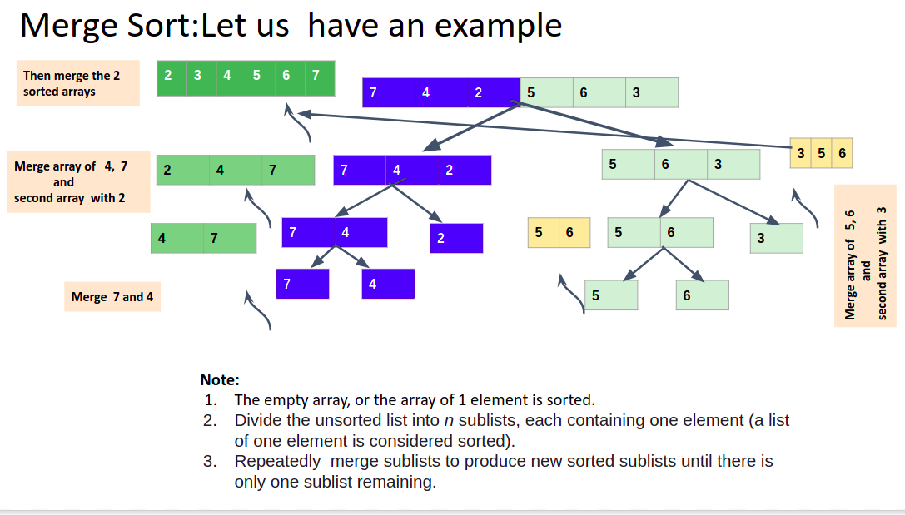

Slide 47
Merge Arrays
Sort
Array
void mergeSort(int a[],int s,int e){
if(s>=e){
return;
}
int mid = (s+e)/2;
int x[100],y[100];
for(int i=s;i<=mid;i++){
x[i] = a[i];
}
for(int i=mid+1;i<=e;i++){
y[i] = a[i];
}
mergeSort(x,s,mid);
mergeSort(y,mid+1,e);
mergeArrays(x,y,a,s,e);
}
void mergeArrays(int x[],int y[],int a[],int s,int e){
int mid = (s+e)/2;
int i=s;
int j = mid+1;
int k = s;
while(i<=mid && j<=e){
//We need to do the Comparison
if(x[i] < y[j]){
a[k] = x[i];
i++;
k++;
}else{
a[k] = y[j];
j++;
k++;
}
}
//Copy Rest of Elements
while(i<=mid){
a[k] = x[i];
k++;
i++;
}
while(j<=e){
a[k] = y[j];
k++;
j++;
}
}
Note:
x: Sorted Array
y: Sorted Array
a: Array to be sorted
s: Starting index
mid: Middle Index
e: End Index
int main(){
int a[] = {7,3,10,5,6,2,-5};
mergeSort(a,0,6);
for(int i=0;i<7;i++){
cout<<a[i]<<" ";
}
return 0;
}

Slide 48
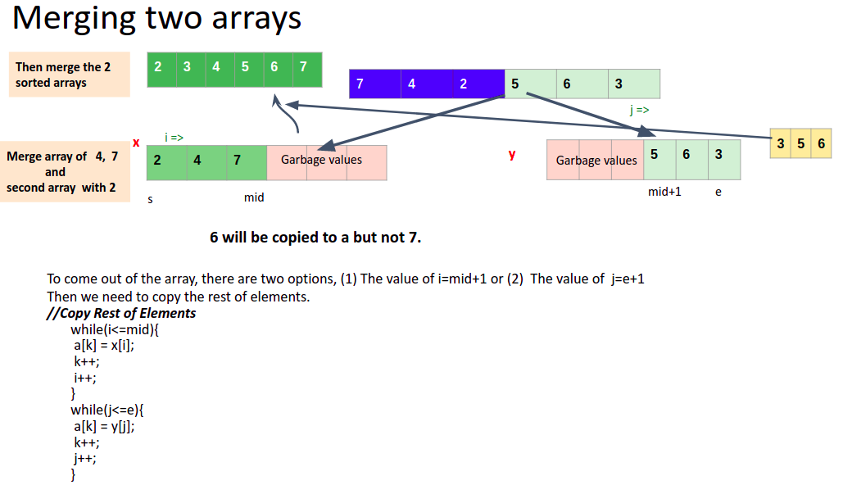

Slide 49
Another option with pointers
void mergeSort(int a[],int s,int e){
//Base case - 1 or 0 elements
if(s>=e){
return;
}
//Follow 3 steps
//1. Divide
int mid = (s+e)/2;
//Recursively the arrays - s,mid and mid+1,e
mergeSort(a,s,mid);
mergeSort(a,mid+1,e);
//Merge the two parts
merge(a,s,e);
}
void merge(int *a,int s,int e){
int mid = (s+e)/2;
int i = s;
int j = mid+1;
int k = s;
int temp[100];
while(i<=mid && j<=e){
if(a[i] < a[j]){
temp[k++] = a[i++];
}
else{
temp[k++] = a[j++];
}
}
while(i<=mid){
temp[k++] = a[i++];
}
while(j<=e){
temp[k++] = a[j++];
}
//We need to copy all element to original arrays
for(int i=s;i<=e;i++){
a[i] = temp[i];
}
}
int main(){
int a[] = {7,3,10,5,6,2,-5};
mergeSort(a,0,6);
for(int i=0;i<7;i++){
cout<<a[i]<<" ";
}
return 0;
}

Slide 50
Quick Sort Algorithm
Recursive Algorithm

Slide 51
Quick Sort
Quick Sort is also a recursive algorithm which is very fast sorting algorithm. The key process in quickSort is a partition().
What is the Quick Sort?
Consider an array a={8,5,2,1,7,3,4}
The target of partitions is, given an array and an element x of an array as the Pivot and put x at its correct position in a sorted array .All the elements greater than the Pivot will be present at the right and all elements less than the Pivot will be present at the left.
In our example of array a, the Pivot is 4;
The Pivot is 4. Now we put 4(Pivot) in its correct position and next we rearrange all elements based on the Pivot. All the elements greater than the 4 will be present at the right and all elements less than 4 will be present at the left even if they are not sorted.
8 | 5 | 2 | 1 | 7 | 3 | 4
This process is Partition=>
2 | 1 | 3 | 4 | 7 | 8 | 5

Slide 52
Quick Sort(next…)
8 | 5 | 2 | 1 | 7 | 3 | 4
2 | 1 | 3 | 4 | 7 | 8 | 5
s
p-1
p
p+1
e
After partitioning, we will apply Quick Sort on the left array and Quick Sort on the right array. After applying Quick Sort on the left array it will be sorted(1,2,3). Then after applying Quick Sort on the right array, it will be Sorted(5,7,8).
1 | 2 | 3 | 4 | 5 | 7 | 8
Then the array is Sorted.

Slide 53
How to calculate the Index of the Pivot for the Sorted Array ?
To know the index of the Pivot, we need to count the elements which are less that the Pivot. The resulting value is the correct index for the Pivot. Then swap the element there and the Pivot.
Note: The Pivot can be any element that is selected by the user as the starting element.
There are many different versions of quickSort that pick pivot in different ways.
Always pick the first element as a pivot.
Always pick the last element as a pivot.
Pick a random element as a pivot.
Pick median as the pivot.

Slide 54
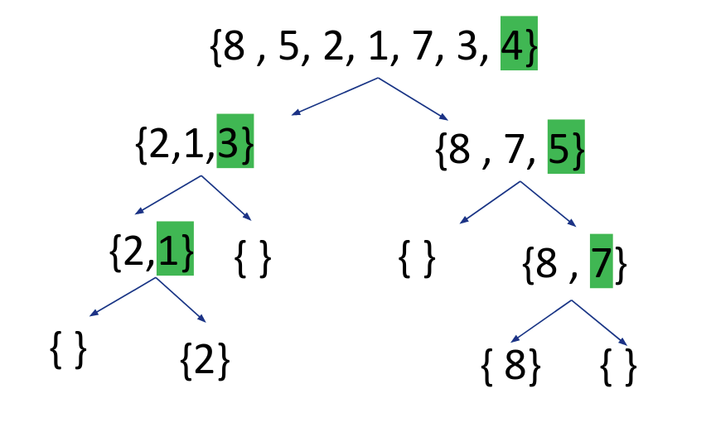
Graphical Representation

Slide 55
Partition function:
Pseudo Code
QuickSort function:
partition (arr[], low, high)
{
// pivot (Element to be placed at right position)
pivot = arr[high];
i = (low – 1) // Index of smaller element and indicates the
// right position of pivot found so far
for (j = low; j <= high- 1; j++){
// If current element is smaller than the pivot
if (arr[j] < pivot){
i++; // increment index of smaller element
swap arr[i] and arr[j]
} }
swap arr[i + 1] and arr[high])
return (i + 1)
}
/* low –> Starting index, high –> Ending index */
quickSort(arr[], low, high) {
if (low < high) {
/* pi is partitioning index, arr[pi] is now at right place */
pi = partition(arr, low, high);
quickSort(arr, low, pi – 1); // Before pi
quickSort(arr, pi + 1, high); // After pi
}

Slide 56
Quick Sort with C++
Pivot as the Last element
void quickSort(int a[],int s,int e){
if(s>=e){
return;
}
int p = partition(a,s,e);
quickSort(a,s,p-1);
quickSort(a,p+1,e);
}
int partition(int a[],int s,int e){
int i=s;
int pivot = a[e];
for(int j=s;j<=e-1;j++){
if(a[j] < pivot){
swap(a[i],a[j]);
i++;
}
}
swap(a[i],a[e]);
return i;
}
int main(){
int a[] = {2,1,3,4,5,7,-2};
quickSort(a,0,6);
for(int i=0;i<7;i++){
cout<<a[i]<<" ";
}
return 0;
}

